Slide 1
Musical Partner
你的練琴好夥伴
2024.6.11
林昱睿、黃驥軒、陳柏睿

Slide 2
Outline
Piano Group Project Overview
The Motivation
Demonstration
Kuramoto Model
The Program Implementation
Physical Setup

Slide 3
The Motivation
Can AI Play Music in Ensemble with Humans?

Slide 4
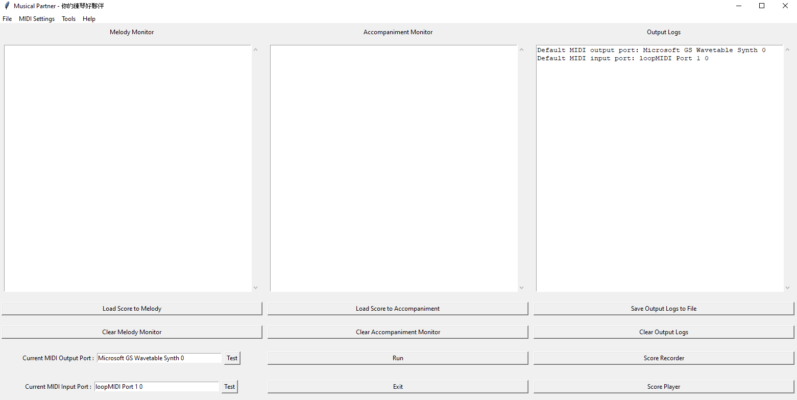
Demonstration

Slide 5
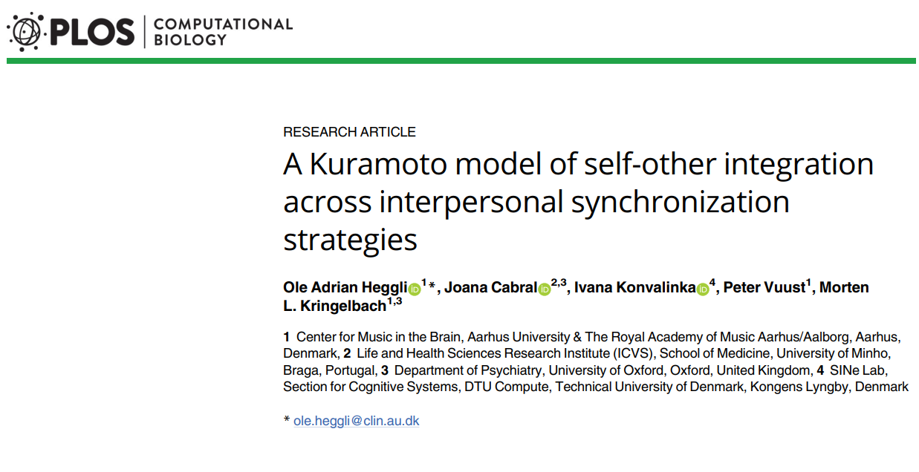
Kuramoto Model
O. Heggli, J. Cabral, I. Konvalinka, P. Vuust, and M. Kringelbach, “A Kuramoto model of self-other integration across interpersonal synchronization strategies,” PLoS Comput. Biol., vol. 15, no. 10, e1007422, 2019.

Slide 6
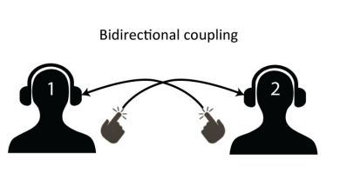
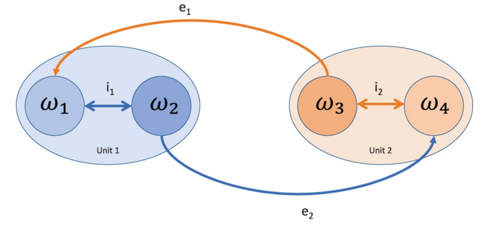
Kuramoto Model
O. Heggli, J. Cabral, I. Konvalinka, P. Vuust, and M. Kringelbach, “A Kuramoto model of self-other integration across interpersonal synchronization strategies,” PLoS Comput. Biol., vol. 15, no. 10, e1007422, 2019.

Slide 7
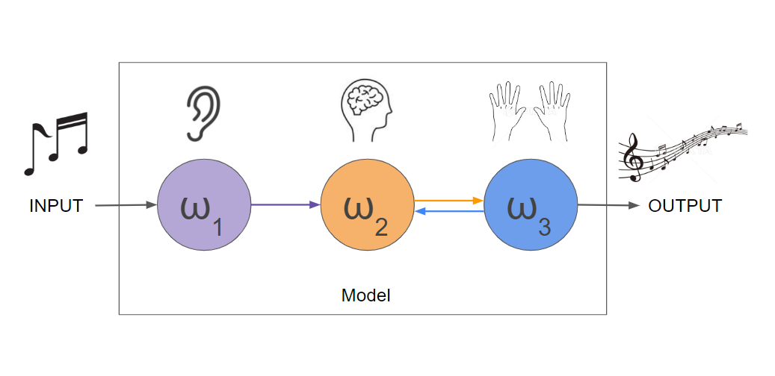
Kuramoto Model

Slide 8
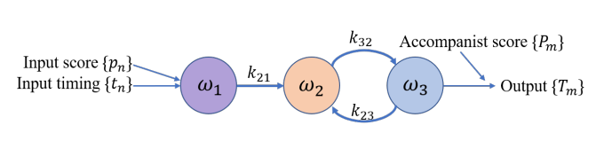

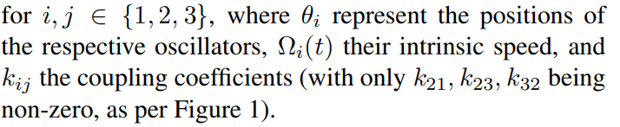
Kuramoto Model
Figure 1. 3-oscillator Kuramoto model, as adapted for use in our model.
It consists of 3 oscillators ω1, ω2, ω3 that are coupled as in Figure 1. Their positions are determined by the coupling equations:

Slide 9
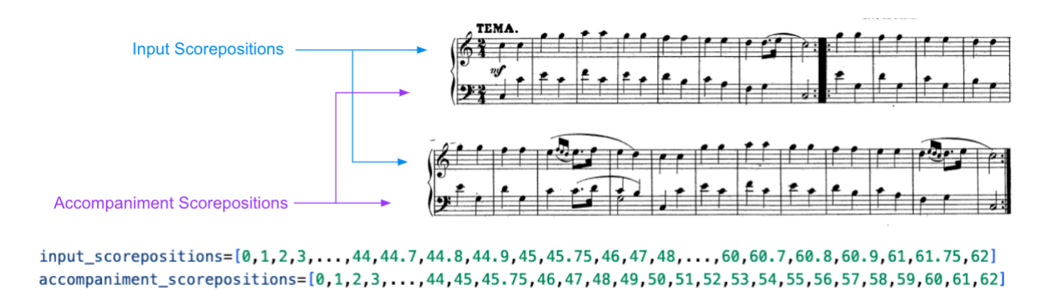
Kuramoto Model
Figure 1. 3-oscillator Kuramoto model, as adapted for use in our model.

Slide 10
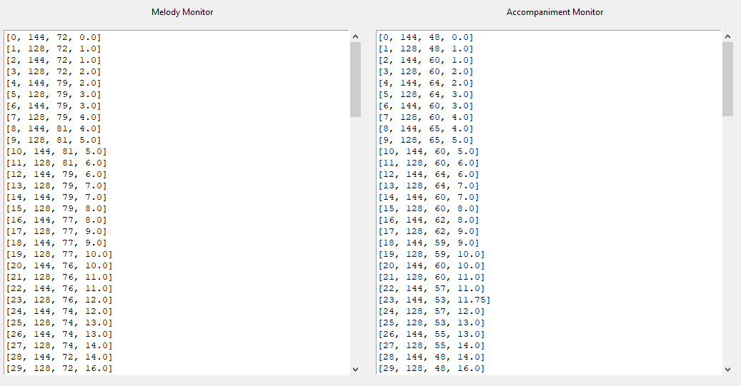
Kuramoto Model

Slide 11
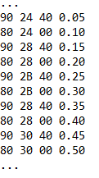
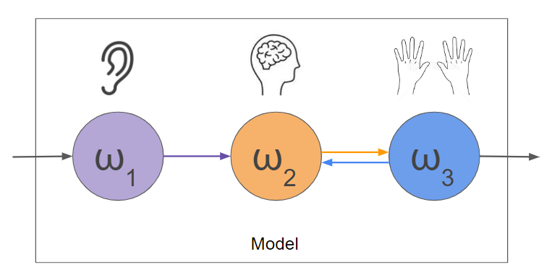
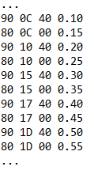
Python Desktop Application
We programmed our model in Python, connecting it to MIDI input and output with RtMidi
The program makes use of a clock (current time), two queues (input and output), and 3 threads
Thread1
Input Reading
Thread2
Calculating
Thread3
MIDI Output

Slide 12
Python Desktop Application
Thread1
Input Reading
Thread2
Calculating
Thread3
MIDI Output
Queue1
Input Queue
Queue2
Output Queue
ω₁
ω₂
ω₃

Slide 13
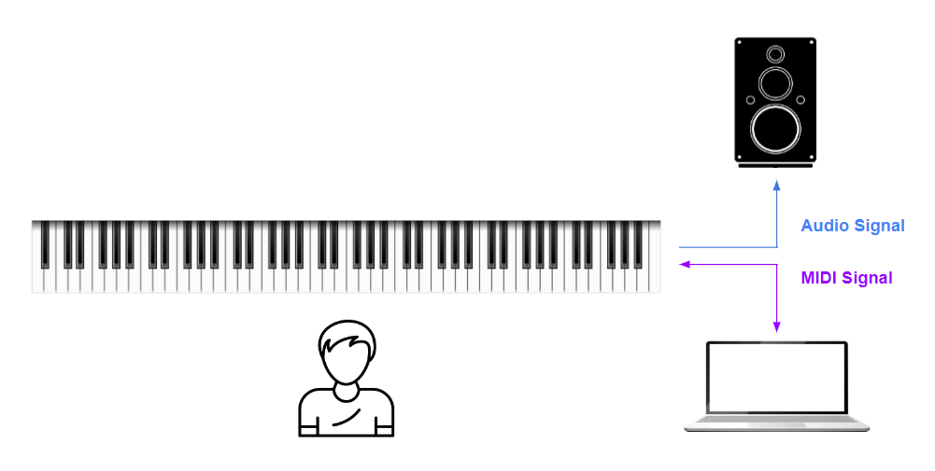
Physical Setup

Slide 14
Q & A

Slide 15
The End

